Slide 1

Science of Learning:
Critical Thinking about Brain-based claims
This presentation is part of a collection of resources for an online workshop for initial teacher education .
The other resources can be found on our website. https://www.bathspa.ac.uk/projects/learning-sciences-in-teacher-education/ and permanently on BathSpa Data
This version is for tutors with tutor notes below the slides. Please adapt it for your own educational purposes.

Slide 2
For tutor to do pre-session
If working on line, use a class register to help you allocate a stimulus sheet number to each student.
Open a data collection sheet for your group

Slide 3
Timings
Experiment
15 minutes experiment (5 minutes to explain task, 10 mins for students to complete independently)
10 mins to explain results and relevance
Research
20-30 minutes research in breakout groups
15 minutes to present

Slide 4


Science of Learning:
Critical Thinking about Brain-based claims

Slide 5
Intended Learning Outcomes
To challenge you to think critically about the science of learning
To consider what is known about learning and the brain
To equip you with the skills to critique claims and to make informed pedagogical decisions

Slide 6
A short research study...
You will be allocated 4 descriptions of scientific studies (scroll to find your allocated sheet number. There will be two pages to look at)
For each study, you will also be given an explanation of the phenomenon described
The explanations may not necessarily be real explanations of the phenomenon
Your task is to rate how convincing you find each explanation on a scale from -3 to 3 and to record this on a spreadsheet
Notes:
5 minutes to explain task, 10 mins for students to complete (example on the next two slides)
Sheet number in grey top left 2 sides for each complete sheet e.g. S1
Experiment Notes:
“We are going to do a quick version of a classic psychological experiment in order to see how evidence is collected by cognitive neuropsychology.
You will get the chance to first experience the experiment from the perspective of a participant, and then later from the perspective of a researcher.
The data collected here will only be used for demonstration purposes in this class; this is not an actual scientific experiment.”
Assign each student to a stimulus sheet (using the register). Give students 10 minutes to read the descriptions and explanations and rate their explanations. Explain that they should write their responses in the spreadsheet. All links are on the Minerva page.
The ‘seductive allure of neuroscience explanations’ experiment
Students will be given the opportunity to experience what it might be like to take part in a psychology experiment. This is a cut- down version of a classic experiment by Deena Weisberg and colleagues in 2008. In this, participants were given descriptions of a number of different psychological phenomena, followed by different types of explanations. These were either ‘good’ explanations, or ‘bad’ (usually a circular redescription of the phenomenon). In addition, these explanations either did or did not contain irrelevant neuroscience – for the explanations that did, the neuroscience content did not add anything to the standalone definition. The key finding from the original study was that people were more likely to rate the ‘bad’ explanation as more satisfying if it contained irrelevant neuroscience. This suggests that we have a blind spot when it comes to neuroscience information, and we might be more likely to believe something if it’s claimed to be ‘brain-based’. Given the prevalence of teaching programs that lack in evidence of actual effectiveness (such as Brain Gym, or concepts such as VAK learning styles), this is likely to be something that trainees will encounter at some point in their careers. As such, equipping them with some basic critical thinking skills may help them to better evaluate such programs in the future.

Slide 7
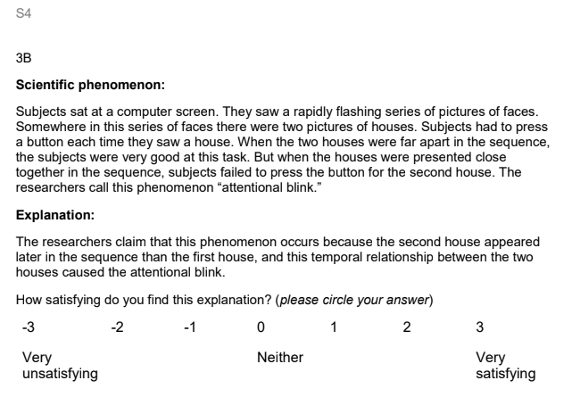
For example,
Look at the letter (B) when you record your response
Sheet number (2 pages)
The study
The explanation
Notes:
Explain that the sheet number is in grey at the top (and that there are two pages to look at per person)
For recording responses, look at the letter rather than the number.
Students need to rate how satisfying they find the explanation of the study, and write the corresponding number in the spreadsheet e.g. 3 (very satisfying) next to B

Slide 8
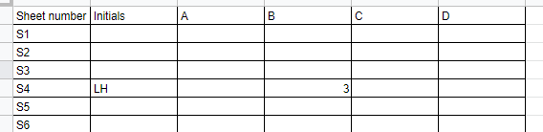
Example recording
Notes:
Sheet S4, initials of the student, 3 (very satisfying) for the explanation of study B (and do the same for the other four explanations)

Slide 9
Collecting the data
Collect the scores for explanation A…, B…, C…, D…
Sheet number | A | B | C | D
Notes:
After students have completed their results, spend 10 mins gathering data, explaining findings and relevance
Ensure the data collection sheet is open
“Before we explain the study, let’s gather the data you’ve just produced.”
Transfer the data from the Response sheet to mock Weisberg data sheet (go to ‘graph’ tab to see the graph):

Slide 10
What is this all about?
This is a quick version of a classic study by Deena Skolnick Weisberg and colleagues called ‘the seductive allure of neuroscience explanations’.
The rationale behind the study was that neuroscience uniquely piques the interest of the general public (we all love to hear about brains).
But does this cause problems when it comes to being objective about neuroscientific explanations?
Notes:
Explain the study then discuss their responses. Present the students’ graphs and discuss what their data shows and compare to actual experiment
Explore how your group’s results compare / contrast with this original study.
Notes on the way the questions were structured:
A = good explanation, no neuroscience
B = bad explanation, no neuroscience
C = good explanation, with irrelevant neuroscience
D = bad explanation, with irrelevant neuroscience
(All student data will need to be deleted at the end due to ethics requirements.)

Slide 11
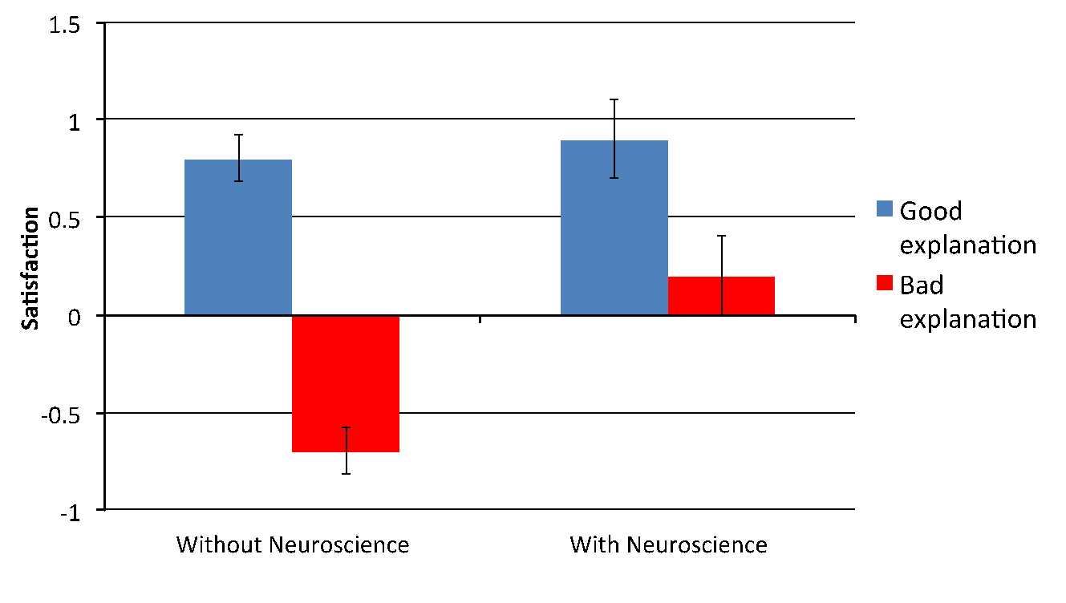
What did the data show?
Notes:
(Don’t show this slide on material provided to students in advance.)
The results of the original study showed that people were able to distinguish good from bad explanations when there were no references to neuroscience (the brain) in the explanation; and were able to detect good explanations when neuroscience was present; but the presence of neuroscience in bad explanations influenced them to rate these explanations as good (even though the neuroscience was irrelevant).
Notes on the way the questions were structured:
A = good explanation, no neuroscience
B = bad explanation, no neuroscience
C = good explanation, with irrelevant neuroscience
D = bad explanation, with irrelevant neuroscience

Slide 12
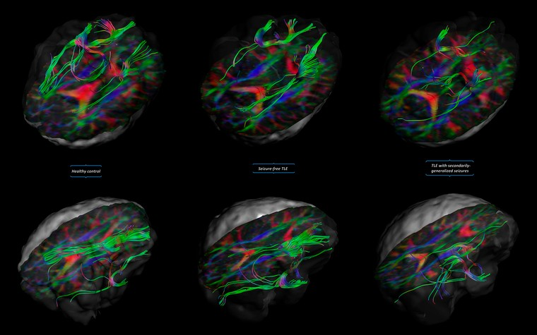
The seductive allure of brain science
We have a blind spot when it comes to neuroscientific explanations
This was also found when including irrelevant brain images alongside educational articles (Im, Varma & Varma, 2017)
Complexity is oversimplified in education
Image Credit: Christopher Whelan, Royal College of Surgeons in Ireland. Attribution 4.0 International (CC BY 4.0)
Notes:
(Don’t show this slide on material provided to students in advance.)
Weisberg’s study provided experimental evidence that we have a blind spot when it comes to neuroscientific ‘explanations’ of things.
This is important, because it suggests that in order to be critical consumers of neuroscience information, we need to be aware of this blind spot.
Neuroscience is a complex field, and although we have learned a lot about the brain in the past century, it is a field still in relative infancy. Neuroscience has been over generalised in education by some people.
So we need to be CRITICAL THINKERS!

Slide 13
The problem of over-application
Limited knowledge about a complex topic, coupled with our blind spot, can result in neuroscience being unhelpfully or needlessly applied in the classroom
examples: ‘brain breaks’, ‘brain gym’
Notes:
NB students may have an emotional response – this was done to many of them!

Slide 14

Does it matter?
Teachers
82 % of teachers responding to our surveys say that they are interested in how the brain works,
54 % had looked up information on the brain in the past four weeks:
75 % had used their understanding of neuroscience to inform classroom practice,
only 25 % report having a good or fair amount of knowledge about neuroscience
Parents
97% said they were interested in how the brain works
57% of parents had looked up information on the brain
Notes:
Image is link to report
– Yes! Teachers and parents are reading about the brain and learning
Wellcome Trust teacher survey (292 responses, open 30 April 2013 to 14 June 2013)
Schoolzone teacher survey (908 responses, open for a 24-hour period on 13 May 2013)
Wellcome Trust parent survey (109 responses, open 30 April 2013 to 14 June 2013)
Musmnet parent survey (100 posts from 86 respondents, open 5 June 2013 to 19 June 2013)

Slide 15

How would you respond?
We must praise children for their effort, not tell them they are clever, to foster a growth mindset.
Anyone can achieve anything if they believe in themselves!
CONSULTANT
She’s like me - no good at maths, but more of a right brained creative thinker.
COLLEAGUE
I’ve seen this brain training app to improve
her maths, what do you think?
PARENT
If you give children frequent tests and quizzes it really helps them to remember the facts.
HEADTEACHER
He’s a kinaesthetic learner – he only learns by doing. Have you done a VAK test with your class?
TEACHING ASSISTANT
Notes:
Explain the increase in popularity of ‘brain-based’ ideas, and that these might be questions they will face in schools

Slide 16
Points to consider
Who is making the claim?
  Are they a researcher with expertise in the area?
  Do they have a financial conflict of interest?
Is the claim based on published research?
  How is ‘learning’ being conceived and evaluated?
  Has the research been replicated? If so, who by?
  Who were the participants? (children, university students, mice)
  Are the data publicly available?
How does the claim fit in to your own beliefs and values?
Notes:
Make links to discussion of Fish oils in science literacy session

Slide 17
Research
Retrieval Practice Brain Training
VAK/Learning styles Left brain/right brain
Mindset
Write a summary of your findings on a shared document. Use these 4 questions to scaffold your analysis.
What were your initial feelings about the idea?
What scientific evidence is there for the idea?
How might you critique the idea?
What are the implications for classroom practice?
Notes:
20 mins
Explain that these have all been/still are popular ideas in education that they may well come across when teaching
Allocate students to 5 breakout rooms/groups or allocate according to numbers and interest in topics
20 minutes in room (Ask students to use a shared document to collate ideas).
Remind groups to choose one spokesperson to feed back to the group
15 minutes feedback on implications for classroom practice (3 mins per group)

Slide 18
Research
Retrieval Practice
VAK/Learning styles
Mindset
Brain Training
Left brain/right brain
Write a summary of your findings on a shared document.
Use these 4 questions to scaffold your analysis.
What were your initial feelings about the idea?
What scientific evidence is there for the idea?
How might you critique the idea?
What are the implications for classroom practice?

Slide 19
Present a claim
Spend 2 or 3 minutes explaining the implications for classroom practice, based on the scientific evidence (or lack thereof)
Notes:
Each group to spend 2 or 3 minutes presenting (give a reminder in the chat when time is up)

Slide 20
Implications for primary teaching
This is not about how to teach neuroscience at primary level. This is more about being aware of the need for critical thinking when you are presented with a learning programme that claims to be ‘brain-based’.
To date there are few robustly tested neuroscience-based initiatives that can be directly applied to the classroom.
Knowledge of the brain is changing fast.
Useful concepts like neuroplasticity and an understanding of the interconnected nature of the brain are emerging, together with a better understanding of memory and of developmental disorders.
Notes:
If faced with a ‘magic bullet’ based on ‘neuroscience’, be wary!
Understanding of the brain may contribute to helping us understand why teaching works or doesn't work, but is unlikely to tell us ‘what works’.
Learning involves the complex interaction of many factors (learner motivation, health, access to resources, cultural capital, quality of teacher explanations….) and any kind of quick fix is highly unlikely.

Slide 21


Post seminar task
Choose one article you have not already read from the Science of Learning collection in the Chartered College of Teaching Journal; Impact. There are 3 pages of articles.
Remember to read this with a critical eye. This can be used as general reading to support your assignments.

Slide 22
References and further reading
Goswami, U. (2015) CHILDREN’S COGNITIVE DEVELOPMENT AND LEARNING, Cambridge Primary Review Trust. Pearson. [accessed 07/08/19] full report
Briefing from the full report available at:
https://impact.chartered.college/issue/issue-2-science-of-learning/
Blakemore, S-J. & Frith, U. (2005) The Learning Brain. Blackwell Publishing.
Burnett, D. (2016) The Idiot Brain. Guardian Faber.
Churches, C. Dommett, E. & Devonshire, I (2017) Neuroscience for Teachers Applying research evidence from brain science. Crown House Publishing.
Conkbayir, M. (2017) Early childhood and neuroscience: Theory, research and implications for practice. London: Bloomsbury.
Goldacre, B. (2008) Bad Science. Fourth Estate.

Slide 23
References and further reading
Howard-Jones, P. (2010) Introducing neuroeducational Research Neuroscience, education and the brain, from contexts to practice. Routledge.
Jarrett, C. (2014) Great Myths of the Brain. Wiley-Blackwell.
Mccrea, P. (2017) Memorable Teaching: Leverage in memory to build deep and durable learning in the classroom.
Tibke, J. (2019) Why the brain matters: A teacher explores some neuroscience. London: Corwin
Im, S. H., Varma, K., & Varma, S. (2017). Extending the seductive allure of neuroscience explanations effect to popular articles about educational topics. British Journal of Educational Psychology, 87(4), 518-534.
Willingham, D. T. (2008) ‘Ask the cognitive scientist: What will improve a student’s memory?’ American Educator. Winter pp. 17 - 25.
Willingham, D.T. (2009) Why Don’t Students like School? A cognitive scientist answers questions about how the mind works and what it means for the classroom. Jossey-Bass Wiley.

