Slide 1




CPD12
Student Experience
Aim: Supporting a positive student experience
Duration: 1 hour
Audience: Lecturers, Course Leaders
Placeholder EP

Slide 2

Learning Outcomes
Identify the unique challenges and needs of mature students at the Educational Partners, and understand the impact of these challenges on their academic experience
Design effective support strategies tailored to the needs of students, enhancing their engagement with the EP
Develop a reflective practice to evaluate strategies and making continuous improvements to better serve mature students
Placeholder EP

Slide 3
Content
Diversity of students
Engagement Strategies
Evaluation and reflective practice
NSS
Placeholder EP

Slide 4

Office for Students Report
Narrowing of options and opportunities for mature students. Digital, online and EP filling this gap.
Pandemic unemployment and need for retraining.
Proposals for the Lifelong Loan Entitlement 2025
Notes:
https://www.officeforstudents.org.uk/publications/improving-opportunity-and-choice-for-mature-students/#Conclusion

Slide 5
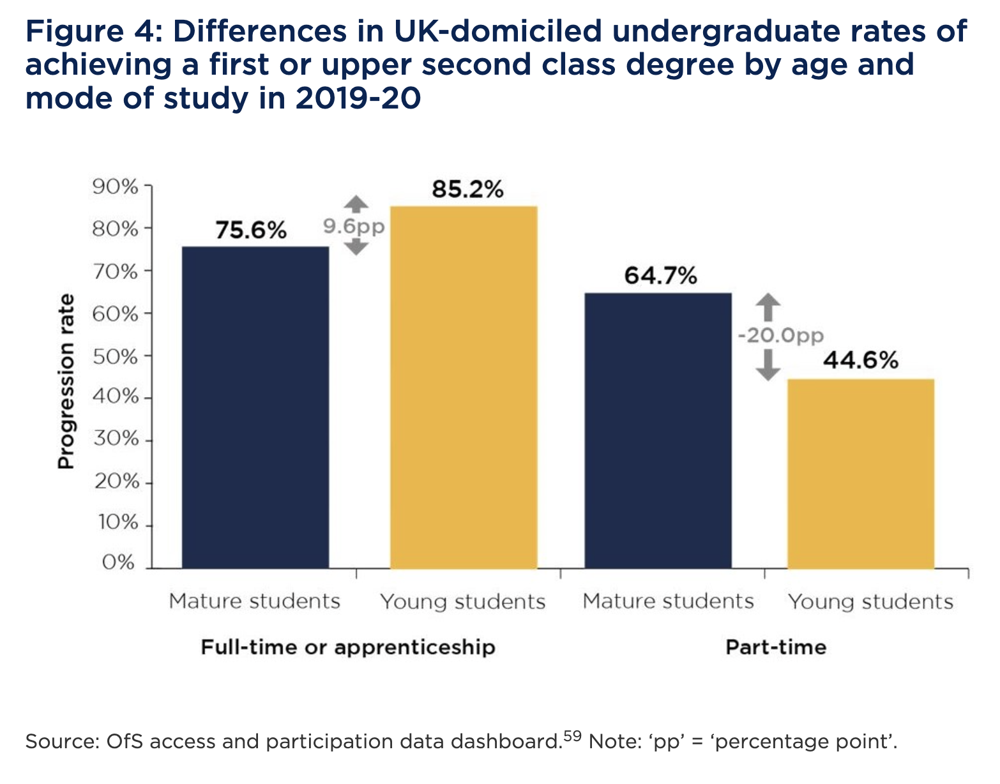
Mature and Young Students
Notes:
https://www.officeforstudents.org.uk/publications/improving-opportunity-and-choice-for-mature-students
While higher education can be transformative for mature students, it is not always geared towards their needs. Mature students are more likely to discontinue their studies. In 2018-19, 84.4 per cent of mature full-time students continued onto their second year, a rate eight percentage points below that for young students. Of part-time mature students, around two-thirds continued into their second year. This was 6.6 percentage points below their younger counterparts.⁵⁶
There is also a degree attainment gap between mature and young students (see Figure 4). In 2019-20, for full-time undergraduates, this gap was 9.6 percentage points.⁵⁷ It has, over recent years, been narrowing. Numbers of young part-time students are small, but the data suggests that attainment is higher (by between 16 and 24 percentage points) among mature part-time students than their younger counterparts.⁵⁸
Description
These gaps in continuation and disparities in attainment have not translated into universal support from universities and colleges. In their access and participation plans submitted to the OfS as of March 2020, only 40 out of 230 included targets related to mature students. Of these, 27 were from universities, the rest from colleges or specialist providers. 37 had written commitments, such as bursaries and student support, and the majority of these related wholly or in part to access.
There is a need for greater choice of how to study, more flexible course structure and improved transitional support, particularly in the first year of higher education, or through foundation years and access courses.⁶⁰ This support could include changes to the course structure, modular provision, evening seminars and childcare.
As we emerge from the pandemic, there will be more need than ever for opportunities to be available to mature students to reskill and upskill. Local opportunities for study and different pathways may be increasingly important, including higher education and further education partnerships, technical qualifications, and Access to Higher Education qualifications. Over the coming year, we will engage with universities and colleges to build these routes more substantially into access and participation plans.

Slide 6
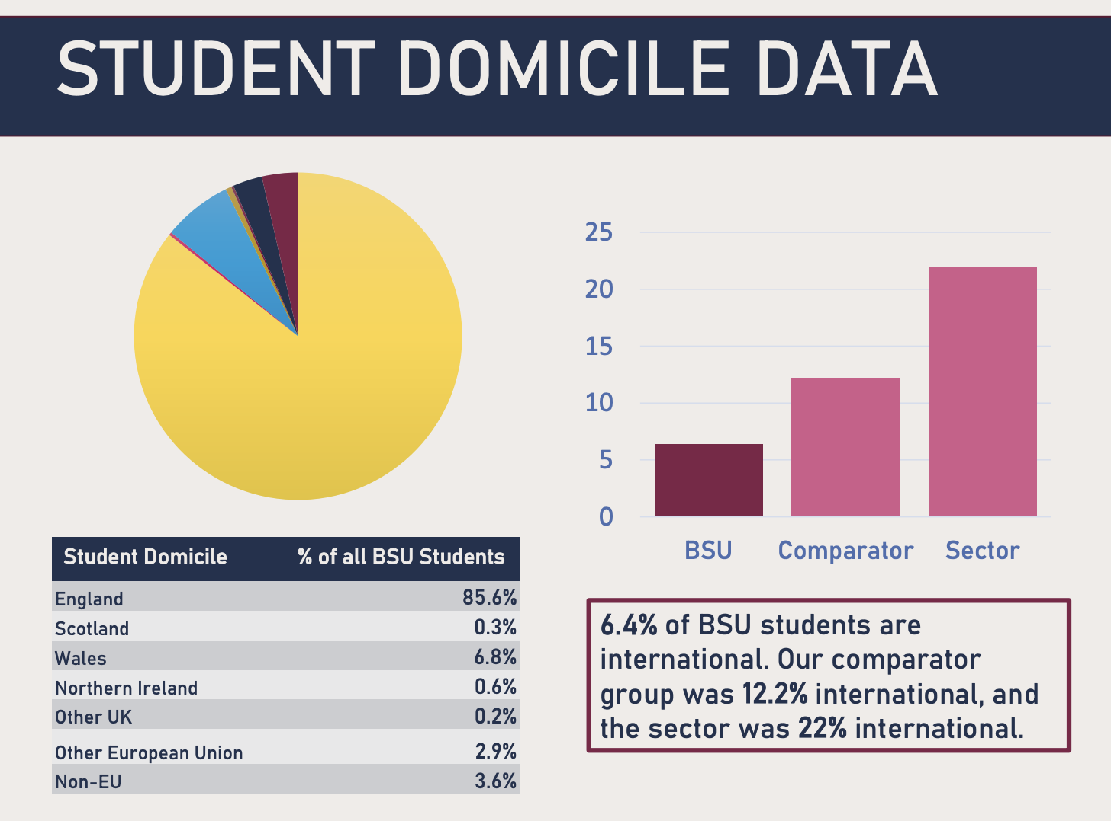
Student Domicile Data
What is the composition in your institution?
Notes:
https://www.bathspa.ac.uk/media/bathspaacuk/hr/work-here/BATH-SPA-COUNTS-2021-final.pdf
International students are attracted to UK HEI. In a report by ICEF Monitor 2022, the UK strategy set out some concrete targets for growth through 2030, including a goal to reach a foreign enrolment of 600,000 students by that year – an overall increase of roughly 30% compared to 2017/18 levels. In 2020 – and nearly a decade ahead of schedule – that enrolment target has already been reached. The latest data release from the Higher Education Statistics Agency (HESA) reports a total of 605,130 international students enrolled for the 2020/21 academic year. This represents a year-over-year increase of nearly 9% from 2019/20 and extends a pattern of steady growth for UK higher education over the last five years. In 2021-22 there were 679,970 international students studying in the UK. 120,140 of these were from the EU and 559,825 were non-EU. In the year ending March 2024, there were 446,924 sponsored study visas and 139,175 Graduate route visas granted to main applicants.

Slide 7



Student Profile
Demographics
Motivations and Goals
Frustrations and Pains
Age
Gender
Family situation
Job situation
Education
Goals
Personality
Time availability
International Cultural Capital
How to engage with students beyond the lecture
Monitoring Systems
Notes:
The purpose of this exercise is to design your classes for your student in mind. It is an exercise from Design Thinking methodologies, thinking about your student as a whole person, beyond the demographics and identifying motivations and goals, frustrations and pains. In this case, these ideas are related with Digital Modes of Engagement. How students engage with the materials: tablet, computer, telephone. Spaces where they interact and engage, and ways to keep them engaged beyond the lecture.

Slide 8
Mature students
Advantages
Intrinsic motivation
Work and life experience
Resilience and adaptability
Challenges
Perceived disadvantages in ways of learning
Complex work/life and care commitments
Notes:
Anything else?

Slide 9
Students from international backgrounds
Advantages
Resilient and adaptable
Cultural diversity
Global networks
Challenges
Language and cultural barriers.
Academic culture and expectations.
Integration
Notes:
Although not so many institutions have international students, some of the students come from international backgrounds, being first generation to attend higher education, and merging british and international cultural settings and context

Slide 10

National Student Survey (NSS)
The NSS is the last part of the puzzle. It is an annual student survey completed by students who are just about to graduate.
Results are also public on the Discover Uni undergraduate course search. Prospective students can see what others thought about any course, and it allows them to compare courses at different universities and colleges.
10

Slide 11
NSS question areas (from the website)
The survey asks final year students to provide feedback on their academic experience relating to the following aspects:
Teaching on my Course
Learning Opportunities
Assessment and Feedback
Academic Support
Organisation and Management
Learning Resources
Student Voice
11

Slide 12
Engagement practices
Lecturers draw on their experience in the classroom
Use a diversity of examples and authors from different countries and regions.
Provide a pre-reading or catch-up opportunities via non-traditional routes
Flexibility and empathy
Tailored services
Attendance
Interaction
Notes:
https://www.plymouth.ac.uk/about-us/teaching-and-learning/supporting-mature-students
What does "engagement" mean?
Attendance is essential. Being fully present in your classes is an important way to develop your subject knowledge, build interpersonal and communication skills (both key for the workplace) and get instant feedback on your ideas from fellow students and tutors.
Interaction matters, too. Interacting with the learning and teaching resources available to you, such as recorded lectures and online library resources shared by your tutors, is an essential way to build up additional knowledge and experience.
A combination of consistent attendance and interaction will help you to achieve the best outcome from your course.

Slide 13
Engagement strategies (1)
Campus | Curriculum | Community
How can the campus be adapted for your type of students (e.g. childcare, gardens) | How is the curriculum adapted to your type of students' needs and what support is offered? (e.g. academic language) | How does your institution enhance a sense of belonging and community support?
Placeholder EP
Notes:
How can your Campus, Curriculum and community are already doing for mature and international students.

Slide 14
Engagement strategies (2)
Campus | Curriculum | Community
How can the campus welcome the student with a rich cultural (international) background)? | How are ideas from decolonising the curriculum being applied in the development of the courses? | How can the institution offer support beyond the degree and create global networks?
Placeholder EP
Notes:
How can your Campus, Curriculum and community are already doing for mature and international students.

Slide 15
Some ideas
Flexible Learning Options
Tailored Support Services
Peer Support Networks
Student Wellbeing
Notes:
Flexible Learning Options: Offering part-time, online, and modular courses to accommodate the diverse schedules of mature students.
Tailored Support Services: Providing dedicated counseling, financial aid, and academic support specifically designed for mature learners
Student Well-being: Providing integral support.
Peer Support Networks: Establishing mentoring programs and study groups to foster a sense of community among mature students.

Slide 16
Evaluation and Reflective Teaching Practice
What are the systems you have in place to support different students (mature/international/caring responsibilities/diverse ethnicity?
How can you co-create these systems with the students?
Start with specific needs/initiatives and evaluate them with the students

Slide 17
Summary
Co-create support with your students
Empathy and care are the key
Flexibility and adaptability
Students’ wellbeing is paramount
Placeholder EP

Slide 18

Just One Thing
Choose one key challenge for mature /international/ caring/diverse students to engage with the courses and work together for a solution
Placeholder EP

Slide 19
Resources
https://heprofessional.co.uk/edition/how-to-support-mature-students-5-action-points-for-universities
https://www.officeforstudents.org.uk/publications/improving-opportunity-and-choice-for-mature-students/#Where%20mature%20students%20study
https://www.bathspa.ac.uk/students/student-wellbeing-services/
Placeholder EP

