Slide 1



CPD7
Accessibility in Teaching and Learning (EDI)
Aim: Activate some of the key areas of BSU Education Principles
Duration: 1 hour
Audience: Lecturers, Course Leaders.
Placeholder EP
Notes:
Check this ultimate guide: https://www.bathspa.ac.uk/media/bathspaacuk/projects/teaching-expertise-guide/Designing-accessible-assessments-v.2024-08-v2.docx

Slide 2


Learning outcomes
Review the core value of Equality, Diversity and Inclusivity (EDI) at BSU and how this is evidenced at the Education Partner (EP)
Explore some tools and recommendations for planning learning and teaching sessions
Assess tools for EP students’ engagement through accessible tools

Slide 3
Content
Equality, Diversity and Inclusivity (EDI) as a core value
BSU Good Practice for Accessible Teaching and Learning:
  Planning Teaching and Learning Sessions
  Learning Materials & Resources
  Teaching
  Collaborative Working
  Assessment

Slide 4
Core Value
We're committed to providing an environment that respects and celebrates all members of our community, and is free from discrimination, prejudice, harassment and bullying.
Notes:
At Bath Spa we recognise that equality, diversity and inclusion are essential to building the creative, innovative and nurturing ethos that we pride ourselves on. That’s why Inclusion forms one of our four core cultural values alongside Respect, Collaboration and Sustainability.

Slide 5
Legal requirements
Equality Act 2010
A person in charge at HEI
Compliance with Standards
Online Physical spaces
Good practice
Enhancement of learning Social Responsibility
Notes:
All universities and higher education colleges should have a person in charge of disability issues that you can talk to about the support they offer.https://www.gov.uk/rights-disabled-person/education-rights
Web Content Accessibility Guidelines. WCAG

Slide 6
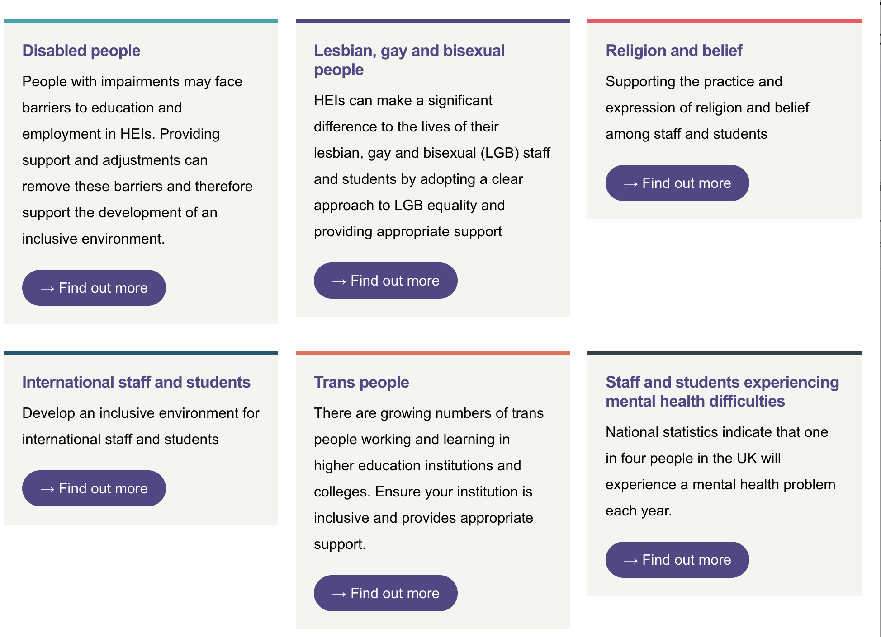

Groups of students needing support
Notes:
All universities and higher education colleges should have a person in charge of disability issues that you can talk to about the support they offer.https://www.gov.uk/rights-disabled-person/education-rights
Web Content Accessibility Guidelines. WCAG

Slide 7
Collaborative work
Consider how learners get the most out of collaborative work
Discuss collaborative work assignments in advance with students
Approach collaborative work with empathy and care
Provide alternatives where appropriate
Notes:
Consider how to help learners get the most out of collaborative work
Collaborative work can be difficult for learners, especially when working with others that they do not typically work with. Consider supporting the development of interpersonal relationships through facilitating activities such as icebreakers.
Do not assume that all learners have sufficiently developed collaborative/group work skills at the outset. Consider how you can support learners to develop skills in this area and try to dedicate time to exploring this with your students. Useful guidance is provided by the universities of Sheffield, Leeds and Portsmouth.
Difficulties frequently arise in collaborative work where groups of learners have misaligned expectations. Ensure to give appropriate time to explain the activity and its parameters, as well as facilitating groups in discussing how they will work together most effectively.
Discuss collaborative work assignments in advance with students.
Ensure you dedicate appropriate time and focus to explaining the task and requirements. This allows students to get a deeper understanding of requirements and appraise whether and how they may find this difficult.
Make clear to students that they can approach the module’s teachers with any concerns. Talk to the student to try understand their difficulties.
Approach collaborative work with empathy and care.
Some students may have anxieties or difficulties regarding working with others.
Discuss this with the student to try to suggest minor adjustments to make the group work easier for them. For example, they may find it easier to work with their peers online rather than in-person, or they may find it easier to work with a group of familiar peers.
Provide alternative tasks where appropriate.
It is likely that most students will be supported through the above minor adjustments.
Some students may still be unable to contribute to collaborative work. Where this is already known, they will have an AAP stating that they “cannot complete group work, please provide alternative individual task”. In these cases, an alternative should be agreed. If it is an assessment, follow the guidance in the Assessments section on providing an alternative assessment task.

Slide 8



Student Profile
Neurodiversity and modes of learning
Well-being
is paramount
Empathy and care
Physical and online environments
How students move from one space to other
Digital modes
Giving enough time and space for listening to students and make reasonable adjustments
Accessibility checker
Notes:
Make it yours: The purpose of this exercise is to design your classes for your student in mind. It is an exercise from Design Thinking methodologies, thinking about your student as a whole person, and having well being as the core of this exercise. Think about how students move from one learning space to other, what is their personal experience and how you can make time for listening and activate reasonable adjustments.

Slide 9
Education Design Principles
CONNECTIVITY
CREATIVITY
INCLUSIVE TEACHING
Active Learning
COLLABORATIVE LEARNING
SUSTAINABILITY
DIGITAL FLUENCY
CURIOSITY DRIVEN PEDAGOGIES
Notes:
Active Learning connects the dots…. Bath Spa University: Education Design Principles
These principles provide a summary of our Education Strategy 2030 Objectives and outline the nature of our students’ educational experience and gains.
Summary & Contents
Connectivity: 1
Creativity: 2
Sustainability: 2
Digital Fluency: 2
Inclusive teaching: 2
Collaborative learning: 2
Curiosity-driven Pedagogies: 2
How can these Principles be used? 2
What does this mean for curriculum design? 3
Education Design Principles
A transformative learning journey with BSU enables:
Connectivity;
Creativity;
Sustainability and
Digital Fluency
Through inclusive, collaborative and curiosity-driven pedagogies.
Underpinning these principles is a commitment by the University to support staff in the development of their expertise for teaching in higher education.
Connectivity:
Students are connected with their future careers through developing their academic and employability skills, and their confidence;
Students are challenged at the forefront of their disciplines through the connection of curricula with research, professional practice and knowledge exchange activities.
Creativity:
Students are encouraged to explore, experiment, and reflect, including through cross-disciplinary activities, and through opportunities for active learning and authentic assessment.
Sustainability:
Students experience academic programmes that are regionally anchored and address global challenges, including environmental sustainability, through the UN Sustainable Development Goals.
Digital Fluency:
Students use and experience relevant and appropriate technologies, including through blended learning, and have opportunities to evaluate and develop their digital capabilities.
Inclusive teaching:
Our curriculum, learning resources and activities are diverse, inclusive and accessible, enabling a sense of belonging, opportunity and ambition.
Collaborative learning:
Our ways of working are enhanced through supportive learning communities. Staff and students engage in collaborative activities with peers and together through co-creation.
Curiosity-driven Pedagogies:
Our staff take an evidence-informed and scholarly approach to developing their curricula and teaching practices, and are supported in developing their expertise for teaching.
How can these Principles be used?
These principles can be used as an aide memoire of the Education Strategy for a variety of activities, for example designing and reviewing academic modules and programmes; planning or evaluating for student experience-related projects and initiatives.
What does this mean for curriculum design?
We take a thoughtful and evidence-informed approach to curriculum design at modular and programme level. At all stages we consider how the Education Design Principles are enacted:
Big Picture: we step back and consider the overall intention of our module or programme.
How will it change our students’ ways of thinking about and viewing the subject and the world?
What are the big ideas and concepts they will need to get? For modules, how does this connect with other modules to create a coherent programme picture?
Aims: having considered the bigger picture this can now be articulated as the educational aims of the module or programme. The aims are statements of the University’s intention for the module or programme, these might include: its purpose, the audience, and where it fits in the context of careers and/or further study. These aims will help students understand broadly what they should expect to gain from participating in the module or programme. Articulating these aims together as a teaching team (and with students through co-creation) helps to ensure a shared vision.
Learning Outcomes: the educational aims articulate what the module or programme intends to achieve. The intended learning outcomes articulate what the student will be able to do as a result of actively participating.
Assessment: assessment evaluates the extent to which the student has achieved the learning outcomes. If thoughtfully planned, it can also act as a vehicle to enable better learning. The type of assessment and learning activity/activities should be clearly aligned to the learning outcomes.
Learning Activities: learning activities are designed to provide a clear structure for students to enable them to navigate through the module and programme, and to develop the skills, knowledge and ways of thinking and practising required to meet the learning outcomes. This structure can be communicated and supported through the use of Ultra. This structured learning can be complemented by enhanced learning opportunities such as co-curricular support from Academic Skills (Ask), the Library, and Careers & Employability.
Resources: what resources do we need to ensure an effective learning experience? As well as teaching staff and materials, resources might include those from professional services such as the Library, Academic Skills (ASk), Careers & Employability, Student Wellbeing Services (SWS) etc; LinkedIn learning (and other e-learning tools); and specialist space (e.g. labs or studios), technologies and associated technical support.

Slide 10
Inclusive Learning
My teaching, learning and assessment materials and activities are inclusive and accessible
My teaching and learning activities draw on a diversity of contributors to the discipline
Top Tip
Activate the Accessibility
Function in your PowerPoint
INCLUSIVE TEACHING

Slide 11
Empathy, clarity and communication
PLANNING
LEARNING MATERIALS
How am I communicating the learning materials and how are students understanding them and reacting to them?
Preparation
Time
Adapt
TEACHING
COLLABORATIVE WORK AND ASSESSMENT

Slide 12
Make it yours
 | Relevant practice at your institution
Planning
Learning Materials
Teaching
Assessment
Notes:
How these aspects are done now at your institution.

Slide 13
Planning teaching sessions
Sessions should be broken down into discrete activities, each ideally around 10-20 minutes long
Schedule whole-class breaks (5-10 minutes per hour) in sessions over an hour
Provide preparatory work to students 1 week in advance of the session
Provide module reading lists to students before the start of teaching a module
Notes:
Planning Teaching and Learning Sessions
Sessions should be broken down into discrete activities, each ideally around 10-20 minutes long.
Activities should ideally be around 10-20 minutes in length. Longer activities should be broken into distinct stages of about this duration. This helps to aid student attention.
Try to avoid lengthy teacher-focused activities, as this may inhibit student attention. Teacher-focused activities (e.g. lecturing) should ideally be limited to 10-20 minutes at a time and be interspersed with meaningful student-focused activities.
Try not to change activity too frequently or have many activities which are very short (less than 10 minutes). Some students can struggle to transition their focus from one activity to another.
Consider how to help students transition focus between activities or topics. Signpost to students when moving from one section to another, and be explicit about how one activity leads into another. When changing topic, it is useful to give time for students to assimilate learning before moving onto the next topic.
Schedule whole-class breaks (5-10 minutes per hour) in sessions over an hour.
It is usually appropriate to schedule whole-class breaks of 5-10 minute approximately every hour for sessions which are over an hour. This mitigates against fatigue and loss of concentration.
It is important to “ringfence” these breaks. Avoid actions which pressure students to skip breaks (e.g. avoid offering learners a vote on whether to skip breaks and finish early, avoid scheduling optional tasks which can be completed during the break).
In addition, any student should be permitted to take breaks at any time and leave the room when needed. This should be permitted without question, explanation or permission wherever possible.
Tutors should make these principles clear to students so they know what to expect. This could be done at the start of a module.
Provide preparatory work to students 1 week in advance of the session.
This applies to all activities where you expect a student to do something in advance of a contact session. This is often referred to as “prep work”, “preparatory tasks”, “pre reading”, or similar.
Students should be given sufficient time in order to prepare for a contact session. One week is usually sufficient time in most cases, though longer preparatory activities may necessitate this being given to students with more time.
Provide resources 48 hours on Ultra in advance of a session.
In most cases this will normally comprise a draft PowerPoint and/or session plan, as well as any resources used within the session.
This can help students prepare for a session in various ways (e.g. those who may wish to run resources through a screen reader before a session, adjust its formatting, etc.).
If you are able to make these documents available even further in advance (e.g. a week in advance), this is often helpful to students. But 48 hours is the minimum expectation.
Provide module reading lists to students before the start of teaching a module.
This can facilitate students who wish to orientate themselves on the topic of the module before starting learning.
It is appreciated that a reading lists provided at the start of a module may not be its final form, and the list may grow from week to week. A good start for an initial reading list are those resources listed in the module descriptor (see the Definitive Programme Documentations linked here; requires BSU login).
This reading list should be provided via Talis and linked from the module’s Ultra page. Further information and guidance can be found here (requires BSU login).

Slide 14
Learning materials
Use a varied range of audio/visual resources to support better a range of learners
Ensure all documents (including PowerPoints) are provided in accessible format
Make the resources customisable by the student
Use meaningful file names
Use accessibility checkers
Provide guidance on essential/prioritised reading
Notes:
Use a varied range of audio/visual resources to support better a range of learners.
Try to think of ways to support verbal information using audiovisual aids, such as graphs, flow charts, mind-maps, video clips, music, videos, pictures, etc.
Try to think of multisensory approaches to support learning, e.g hands-on artefacts.
Ensure all documents (including PowerPoints) are provided in accessible format.
Guidance can be found in this BSU Quick guide to creating accessible content (requires BSU Login). Key points are summarised in a table below, and the guide discusses each in further detail.
Make the resources customisable by the student.
Where possible, students should be able to download the resource from Ultra and adjust the font, size, colours and so on to their individual needs.
Use meaningful file names
Students should be able to identify the document easily by its file name.
Use accessibility checkers and tools to improve your resources.
Documents created in Microsoft (e.g. PowerPoints, Word documents, etc.) can be checked via Microsoft’s Accessibility Checker which identifies significant issues and helps you fix them.
PDFs can be made accessible by using Adobe Acrobat Pro on making accessible PDFs
Documents uploaded to Ultra can have their accessibility checked and improved through Blackboard Ally
Provide guidance on essential/prioritised reading.
If possible, give specific chapter/page numbers to direct students to the most essential content.
Some students have slower processing speeds and might need direction to where specifically in a source the key points are made. There isn’t expectation that students will engage with less scholarship, just that they might need additional signposting to the main points.
Further BSU Guidance on making accessible documents:
The BSU Accessibility Site
Make MS Office documents accessible
Digital content must be accessible
VLE Minimum Expectations

Slide 15
Teaching
Provide advance notice of changes to timetables session or room
Allow students to choose seating position
Communicate in an accessible way
Provide clear instruction and allow time to respond to questions
Record all taught sessions
Check on students’ learning at regular intervals
Notes:
Provide advance notice of changes to timetabled session/room
Where possible, this should be done 48 hours in advance through an announcement to students on Ultra
Allow student to choose seating position wherever possible.
This allows students to situate themselves in places most constructive for their learning.
Some AAPs may note if a student has especial need to sit in a particular place (e.g. at the front and centre to lipread).
When asking students to move to a particular location in the room (e.g. moving into groups for collaborative work), it is good practice to check with students that this location is suitable for them.
Communicate in an accessible way.
Speak clearly and steadily.
Ensure nothing blocks students’ view of your face so that they can lipread.
Repeat or paraphrase input from other students in larger groups where other students may not have heard this contribution.
Reduce background noise where possible.
Avoid overlapping conversations where possible.
If playing videos, try to ensure appropriate volume and captions are shown where possible.
When setting up activities, provide clear instruction to students.
Explain activities both verbally and through text (e.g. brief instructions on PowerPoint) where possible.
Give all students time to process information following instructions and before starting an activity.
Ask if they have any questions before starting an activity: check that students understand the activity and give them opportunity to clarify anything with you before starting the activity. (You may also consider methods of checking with them so you can ensure they have fully understood the task.)
Provide student time to respond to conversations/questions.
Consider activities such as “think, pair, share” to allow students sufficient time to think through a topic and formulate their thoughts. This comprises a small amount of time (perhaps 2 minutes) for them to think through the topic, then a similar amount of time for them to discuss with a partner, then a further amount of time for the group to come back together and share the outcomes of their discussions.
Consider ways for students to contribute their thoughts anonymously or non-verbally, such as using digital technologies. BSU’s Digital Learning Developer team offer guidance and support on the available collaborative tools such as digital whiteboards and polling software (link requires BSU login).
Where verbal questioning is used, it is recommended that tutors leave appropriate “wait time”: at least 5 seconds of silence after asking a question, if there are no answers, before moving on. This allows greater processing time for students to think of and volunteer an answer. More complex questions will require a longer pause.
Record all taught sessions.
This can help both students who were unable to attend, as well as those who want to recap the session afterwards.
In many cases, the tutor can do this as a recording through Panopto. This is the usual expectation for “lectures” and similar sessions.
Where it is inappropriate or impractical for a tutor to record a session, teachers should try to offer something in place of this in order to facilitate students who wish to catch up/recap. This may comprise, for instance, a short summary (in video or writing) of the content of the session. This more be more appropriate for some discussion-based sessions such as certain “seminars”.
Any student may choose to record a session on their own device to support their own learning. However, it is good practice for the student to inform the teacher that they are doing this. It is inappropriate for the student to use this recording for any purpose beyond supporting their own learning.
Check on student learning at regular intervals, providing opportunities for them to seek clarity.
Teachers should provide several opportunities through a session for students to ask questions; and not just reserve a short period for this at the end of the session.
Teachers should make clear to students the ways in which they can be contacted outside of a session to address any queries regarding the session or module (e.g. email, office hours, etc.). As a minimum, this information should be posted on the module’s Ultra page. It is good practice also to talk to students about this (e.g. in the first session of a module).

Slide 16
Assessment
Give clear advice to students on the assessments, including how to ask questions
Prepare students for events and deadlines
Provide alternative options for assessments where appropriate
Approach extension requests with empathy and care
Notes:
Give clear advice to students on the assessments, including on how to ask questions and receive further support.
This should be posted on Ultra. The VLE Minimum Expectations (requires BSU login) contains information on what information teachers are required to put on Ultra.
You should make clear to students that they should contact the module’s teachers if they foresee or experience any difficulties engaging with any assessment (both formative and summative).
Teachers should make clear to students the ways in which they can be contacted outside of a session to address any queries regarding the assessments (e.g. email, office hours, etc.). As a minimum, this information should be posted on the module’s Ultra page. It is good practice also to talk to students about this (e.g. in the first session of a module).
Prepare students for events, deadlines and changes in the module’s routine which are approaching (e.g. assignment deadlines, presentations, timed assessments, etc.)
The assessment timelines (submission deadlines and feedback return dates) must be published on Ultra during the first week of module delivery sessions. See further the Readiness Checklist for Ultra Module Pages (requires BSU Login).
Give reminders to students as they approach by mentioning these in sessions and/or on Ultra via announcements.
Provide alternative options for assessments where appropriate.
Sometimes it is not possible for students to complete a piece of coursework in the form indicated in the assignment brief. This will often be indicated in a student’s AAP, or it could arise from a student contacting you to discuss this.
The first step should be for the tutor to discuss this with the student. Often a minor adjustment can be made to facilitate their engagement.
Where more significant changes need to be made, you should refer to the student’s AAP and discuss also with the student. This may involve adjusting the submission medium. This is usually acceptable so long as it meets the academic rigour and competencies required. The Student Wellbeing Service can provide support with this; contact via MyServices.
The below table provides an example of common alternatives which could be explored:
Type of Assessment
Alternatives
Presentation
Would presenting to a smaller audience (or just the tutor) help?
Is the difficulty with a synchronous or in-person presentation? If so, consider an asynchronous (pre-recorded) or online presentation.
If the module’s Intended Learning Outcomes do not focus on presentations skills, another medium can likely be selected. Consider: podcast, poster.
Approach extension requests with empathy and care.
Especially when several deadlines coincide.
Ensure these same principles are applied to formative as well as summative assessments.

Slide 17
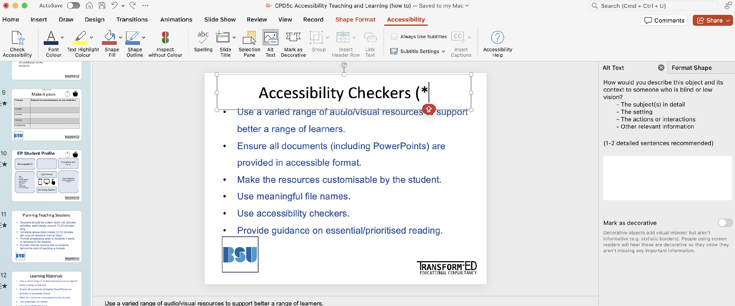

Accessibility checkers

Slide 18
Summary
Equality, Diversity and Inclusivity the umbrella for empathy and care
Accessibility as a key for activating inclusive learning
EDI is related with Students’ wellbeing
18

Slide 19

Just One Thing
Enable the Accessibility Checker in PowerPoint and explore it
Have a look to https://www.bathspa.ac.uk/media/bathspaacuk/projects/teaching-expertise-guide/Designing-accessible-assessments-v.2024-08-v2.docx
19
Notes:
Try one of these activities, only one…

Slide 20
Resources
The ultimate guide from BSU for Accessible Teaching and Learning
JISC guide to Accessibility: What you need to know
Advance HE guide to EDI
Student Well-being at BSU
20

